Slide 1
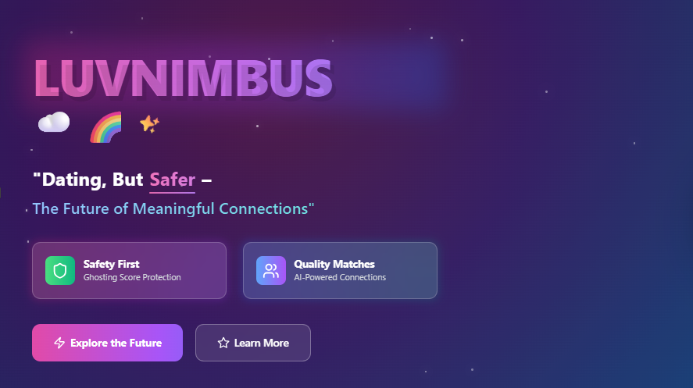
1

Slide 2
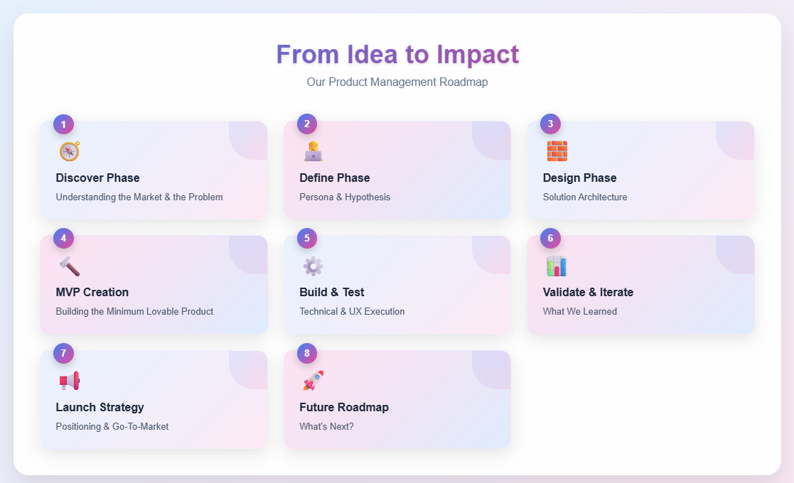



Let's Navigate through the Market Potential
3

Slide 3




Why Existing Apps Fail Users 💔
The current dating market is riddled with challenges that lead to widespread user dissatisfaction. Many individuals experience emotional fatigue from constant ghosting and the endless, often superficial, swiping culture. The prevalence of fake profiles further erodes trust, making it difficult to form genuine connections. For example, popular apps like Tinder have seen their ratings drop significantly, averaging a mere 2.3 stars, reflecting a pervasive sense of disappointment among users.
60%
80%
75%
2.3
Users experience ghosting regularly
Encounter fake profiles
Report swipe fatigue
Average star rating for leading dating apps
4

Slide 4
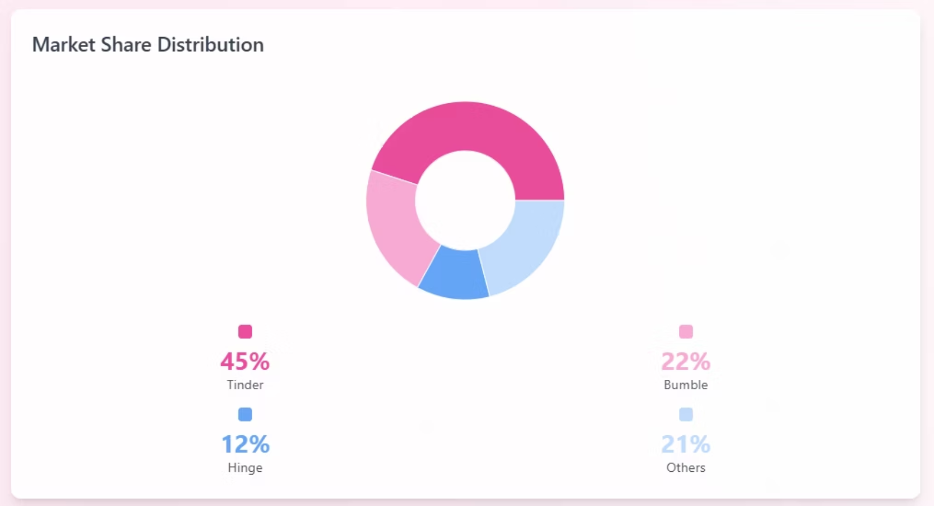
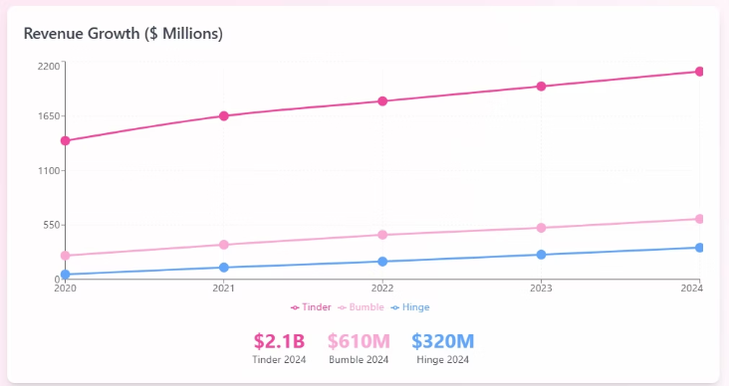
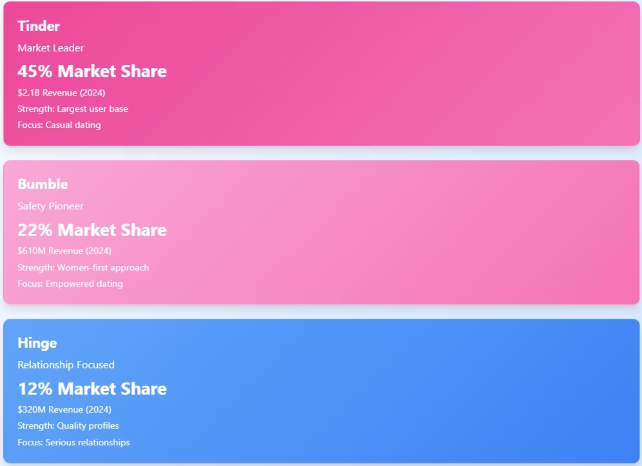
5

Slide 5
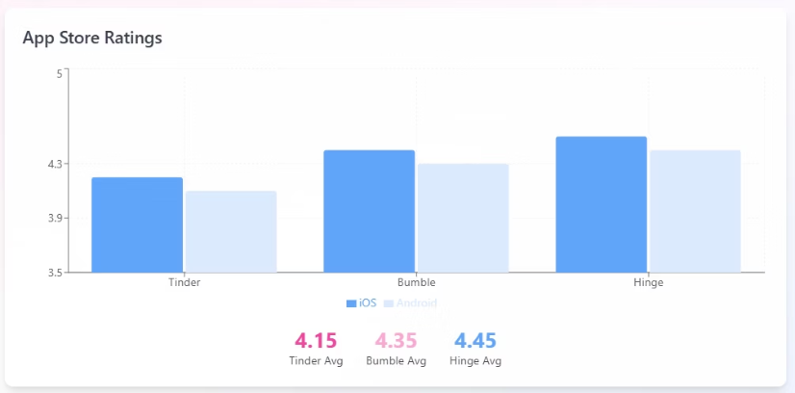
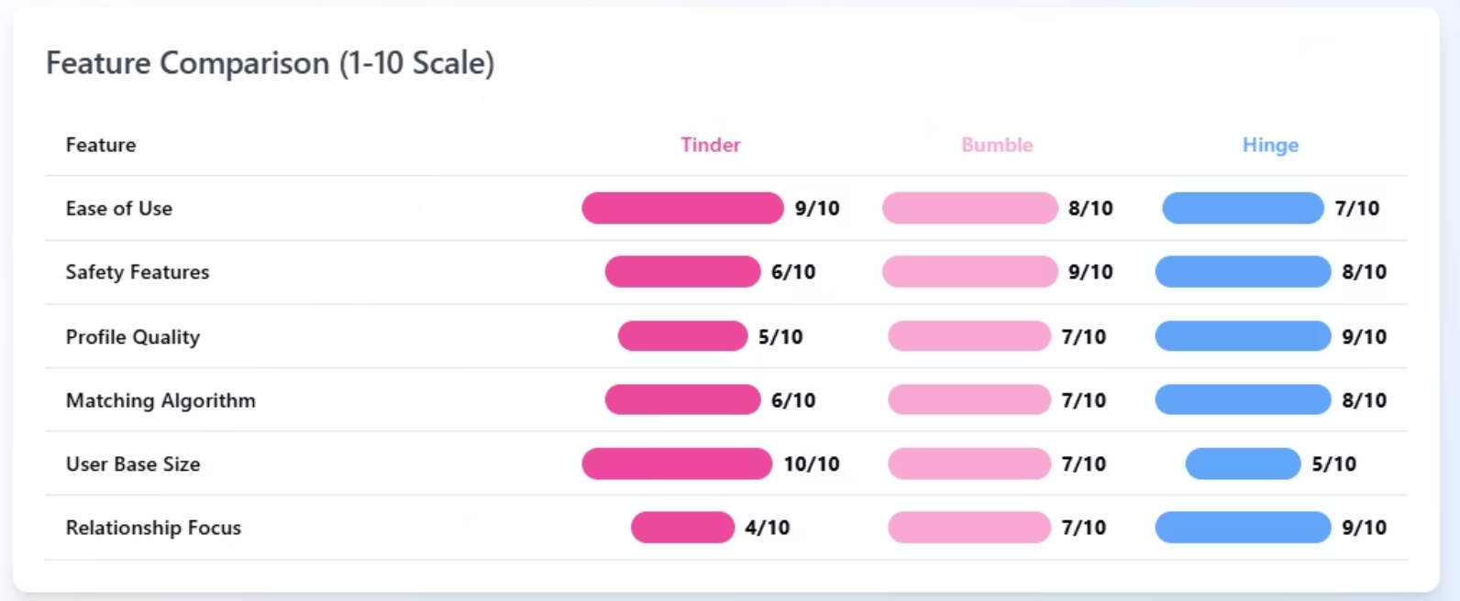
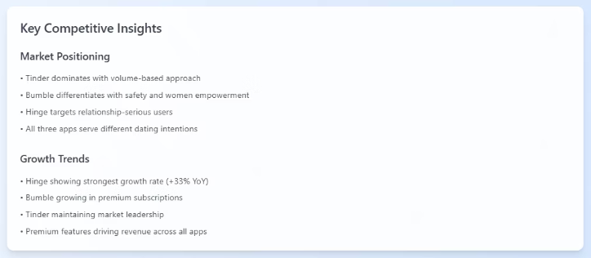
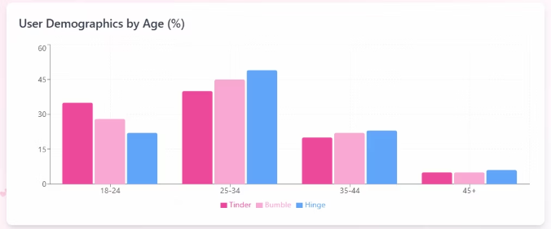
6

Slide 6
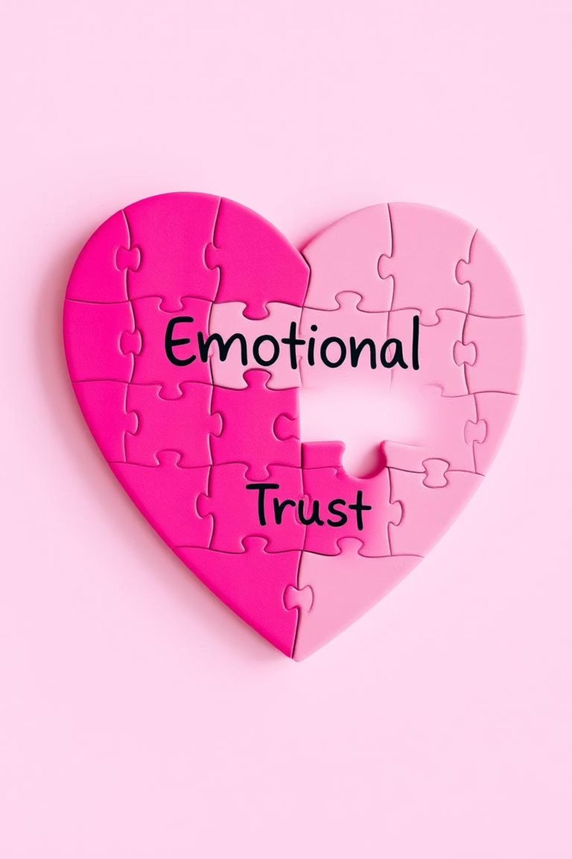



Our Key Discovery – Emotional Intelligence Matters 🧠💖
Through extensive research, we've identified a critical emotional gap in existing dating applications. Users are increasingly yearning for authentic connections over superficial matches. Our insights reveal that emotional trust and mutual respect are paramount drivers of user satisfaction and the foundation for lasting relationships. This understanding forms the core of LuvNimbus's unique approach.
"I'm tired of endless swipes; I want meaningful engagement." – Arjun, 28
Authenticity
Emotional Trust
Genuine interactions lead to deeper bonds.
Building relationships on a foundation of confidence and safety.
Mutual Respect
Valuing each other's time and feelings.
7

Slide 7
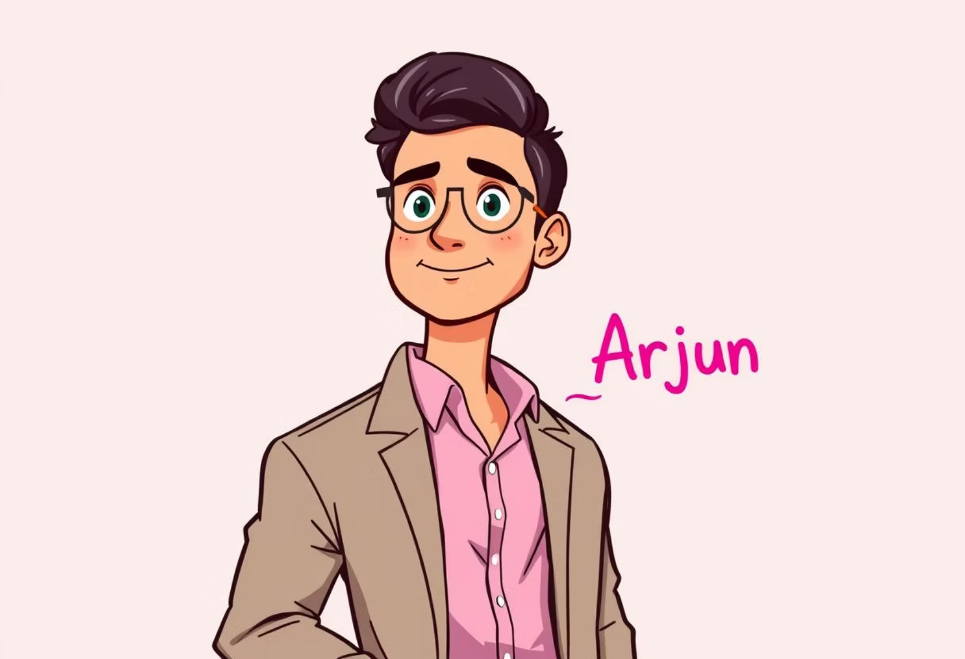
Meet Arjun – The Hopeful Realist 🧑‍💻🎯
To truly understand our users, we've created Arjun Mehta, a persona embodying the frustrations and aspirations of our target audience. Arjun is a 28-year-old software engineer based in Bengaluru. His primary goals are to find authentic connections and engage in meaningful conversations. His pain points include the prevalence of ghosting, the superficiality of typical dating apps, and the general lack of responsiveness he encounters, making his dating journey disheartening.
Demographics
Age: 28
Occupation: Software Engineer
Location: Bengaluru, India
Goals
Authentic connections
Meaningful conversations
Pain Points
Ghosting
Superficiality
Lack of responsiveness
"I wish dating apps valued real conversation over quick swipes."
8

Slide 8
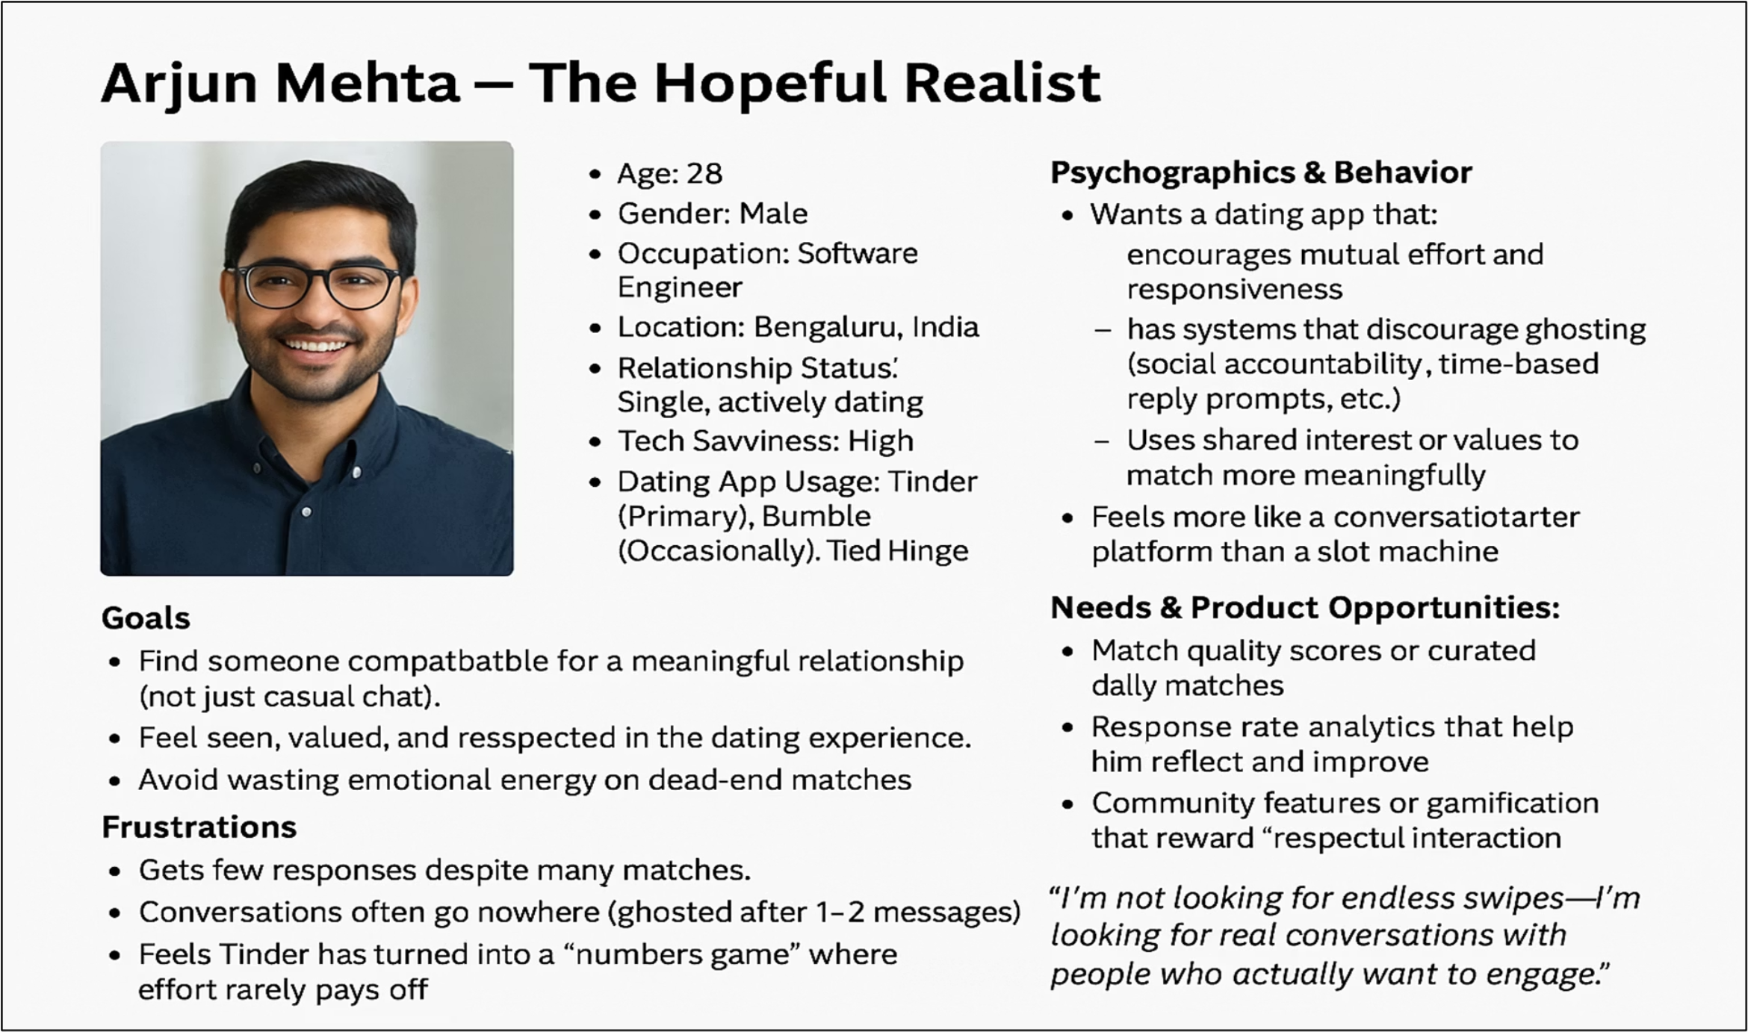
9

Slide 9
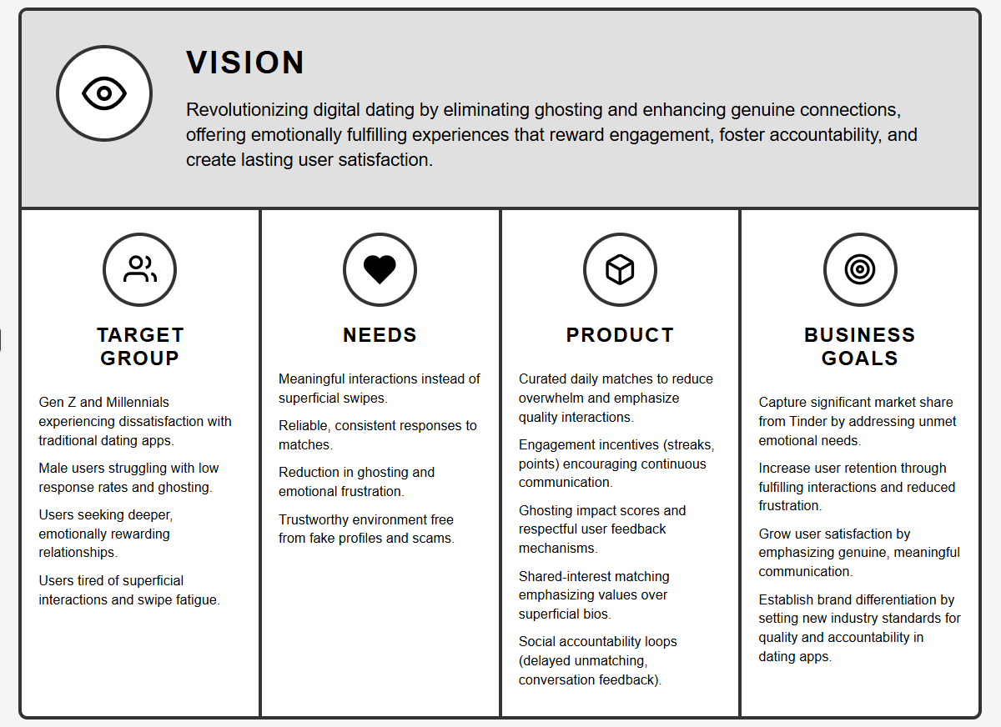
10

Slide 10
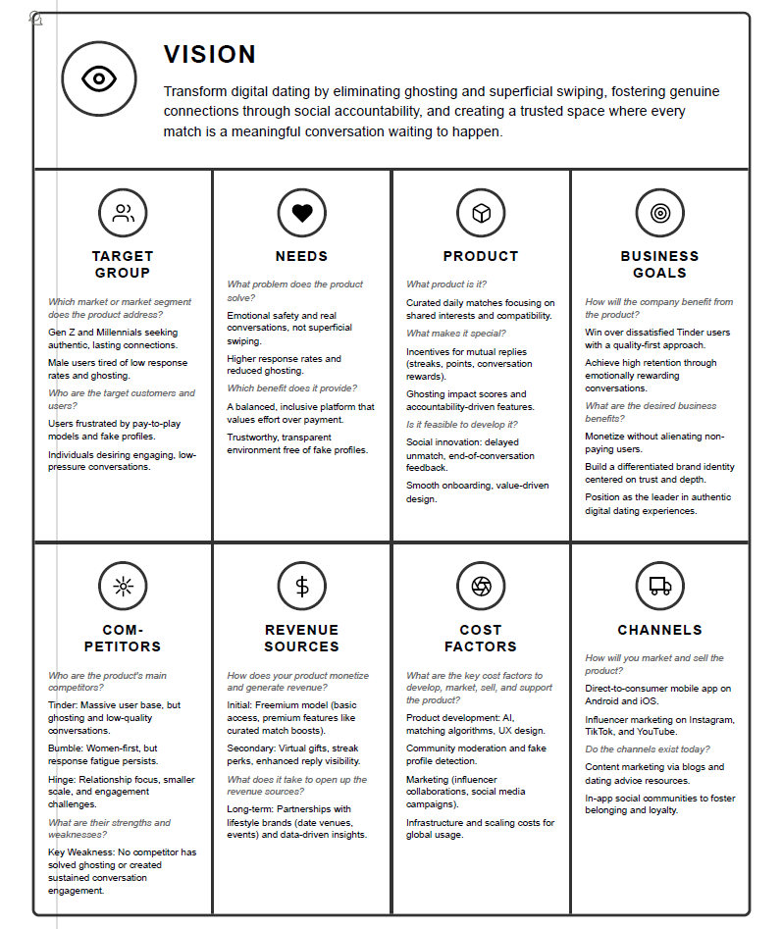
11

Slide 11
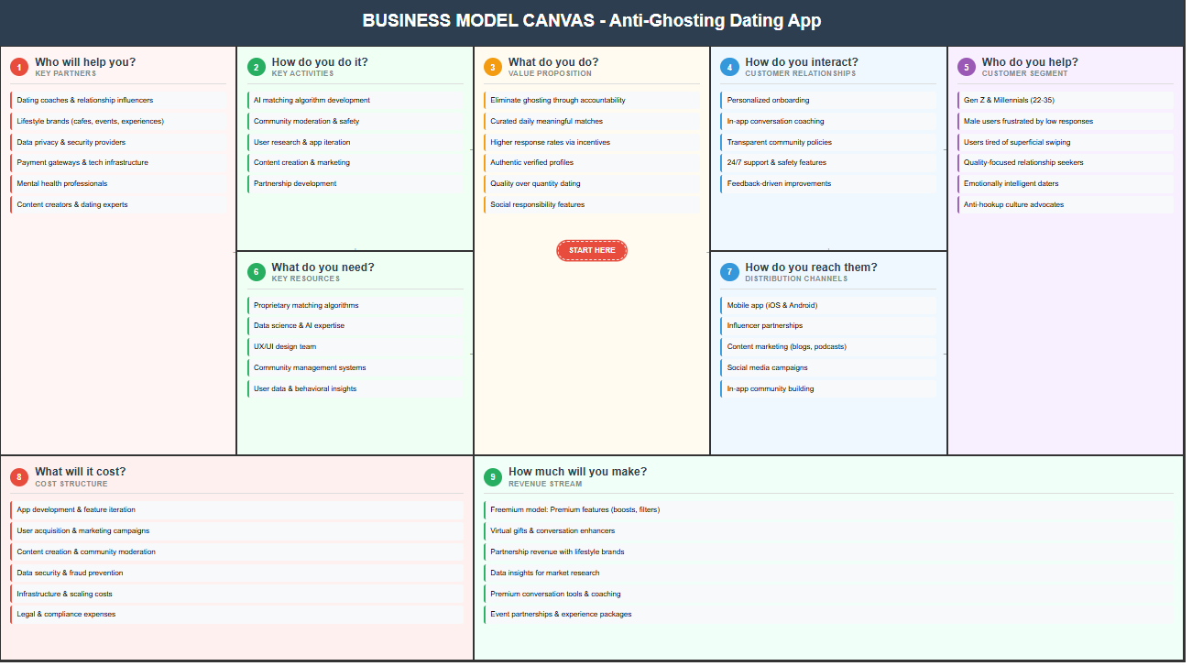
9
12

Slide 12




Strategic Hypothesis: Solving the Emotional Trust Gap 🤝✨
Our core strategic hypothesis is clear: By implementing features that actively eliminate ghosting and incentivize meaningful interaction, LuvNimbus can dramatically increase user satisfaction, improve retention rates, and elevate the overall quality of connections made on our platform. This approach directly addresses the emotional voids identified in the current dating market, fostering a more positive and productive environment for forming relationships.
Key Statement: "By eliminating ghosting and incentivizing meaningful interaction, we can dramatically increase user satisfaction, retention, and connection quality."
Current Problems
Ghosting & superficiality
Our Solution
Anti-ghosting & engagement incentives
Desired Results
Increased satisfaction, retention, & connection quality
13

Slide 13
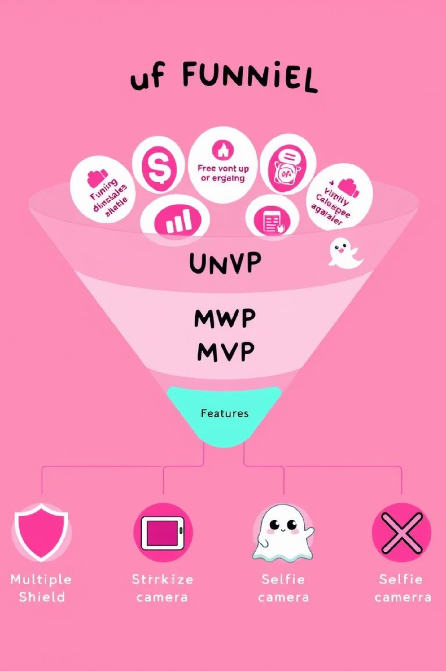




Building Our Minimum Lovable Product (MLP) 🚀🧡
Our focus for the Minimum Lovable Product (MLP) is on essential features that deliver immediate value and address core user pain points. We've prioritized daily curated matches to reduce overwhelm, a trust score via selfie verification to enhance safety, gamified response incentives to boost engagement, and a robust ghosting accountability system to foster respectful communication. These features are designed to create a truly lovable experience from day one.
Daily Curated Matches
Reduces swipe fatigue and focuses on quality.
Trust Score via Selfie Verification
Ensures authenticity and builds user confidence.
Gamified Response Incentives
Encourages prompt and meaningful conversations.
Ghosting Accountability System
Promotes respectful communication and reduces frustration.
14

Slide 14

Introducing
15

Slide 15
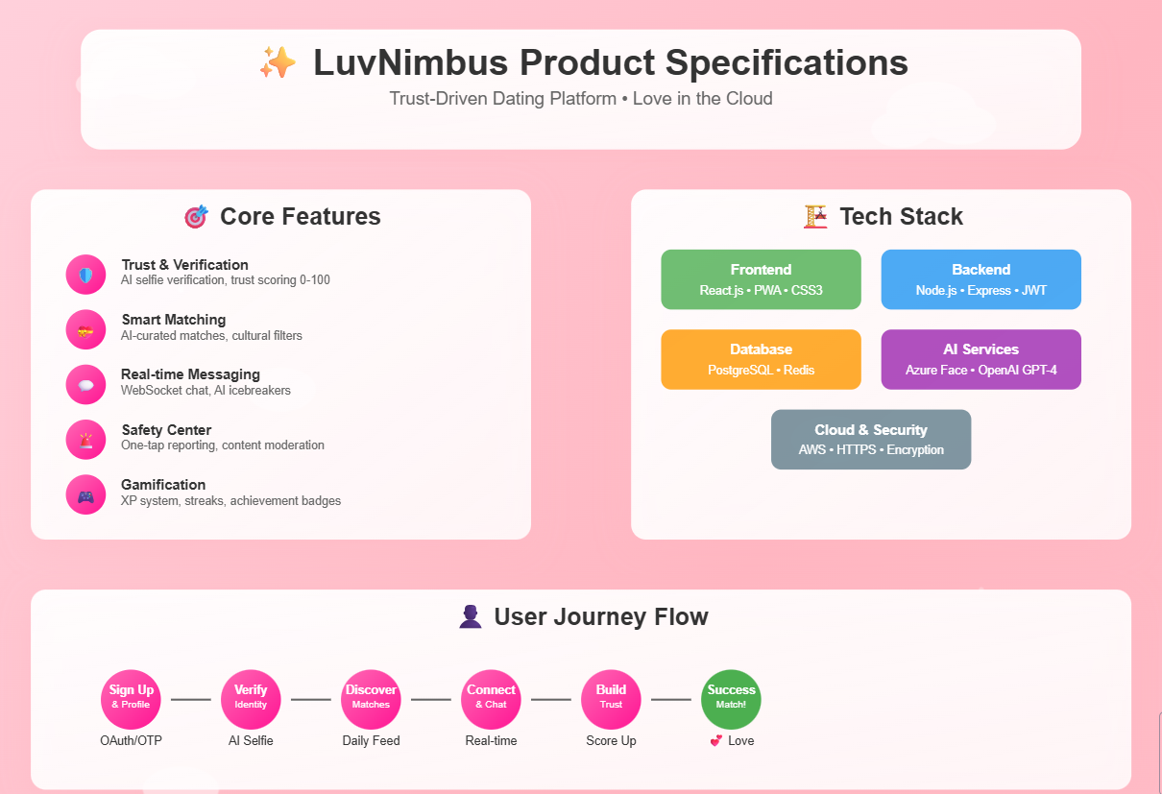
16

Slide 16
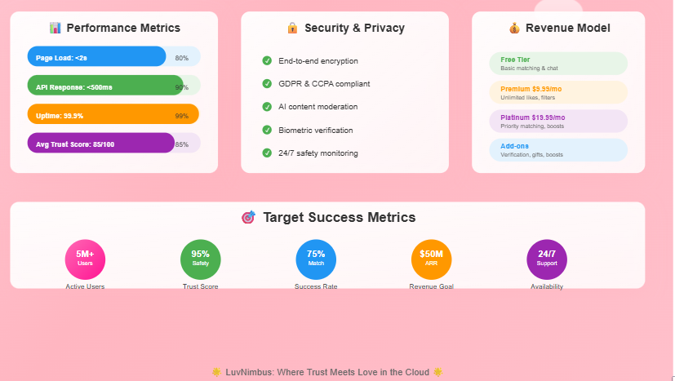
17

Slide 17



User Journey & Wireframes
“Bringing the Experience to Life”
18

Slide 18
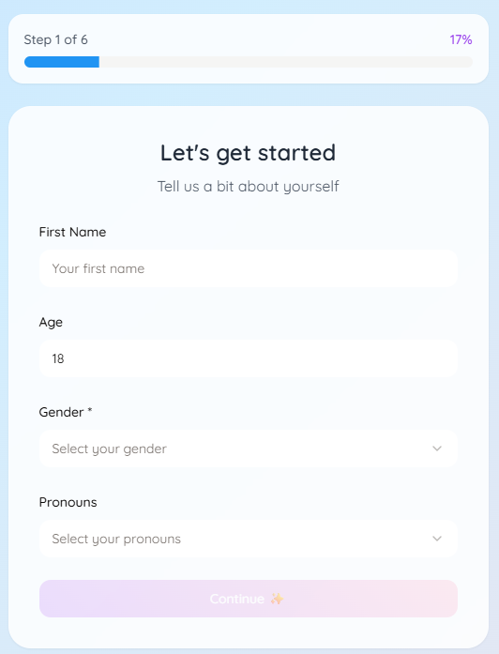
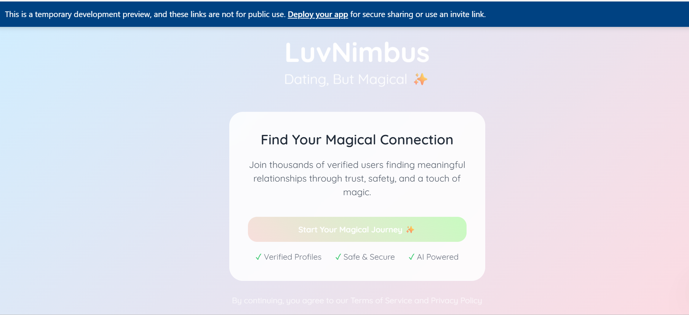
Wireframe 1 – Splash & Intro + Login
Title: “First Impressions – Welcome and Onboarding” Content:
Left: Wireframe of Splash screen (Wireframe 1)
Right: Wireframe of Login/Registration
Caption: “We prioritized fast load, branding, and accessibility from the very first screen.”
19

Slide 19
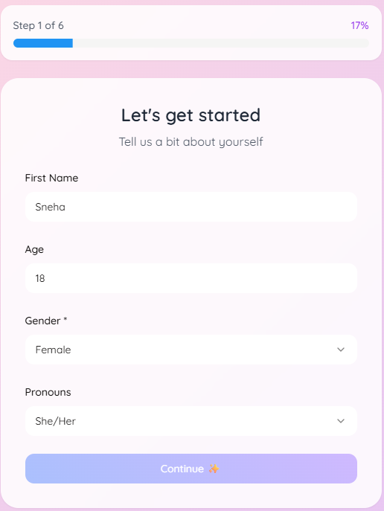
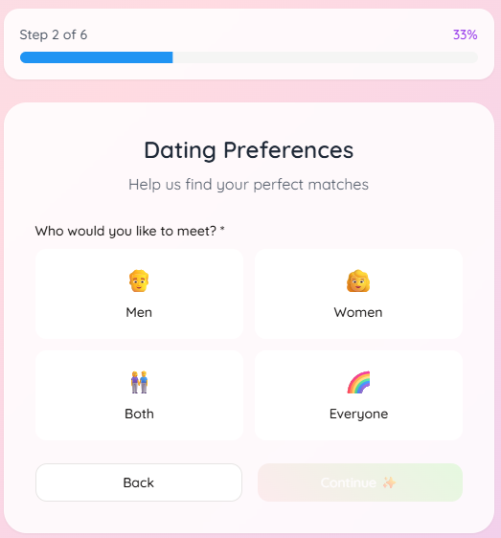
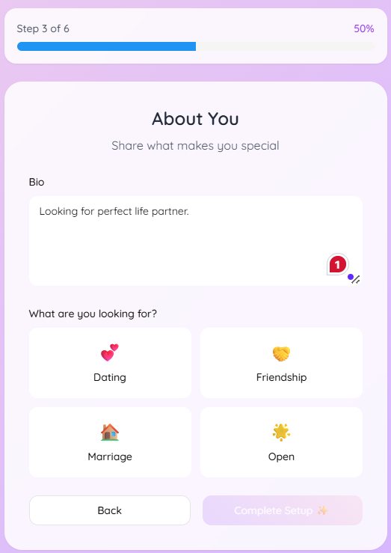
Wireframes 2–3– 4 – Onboarding Flow
Title: “Personalization & Profile Setup” Content:
Wireframes for:
Step-by-step onboarding (photo, info, Dating Preferences, About You)
Highlight: Progress bar, optional privacy tooltips
20

Slide 20
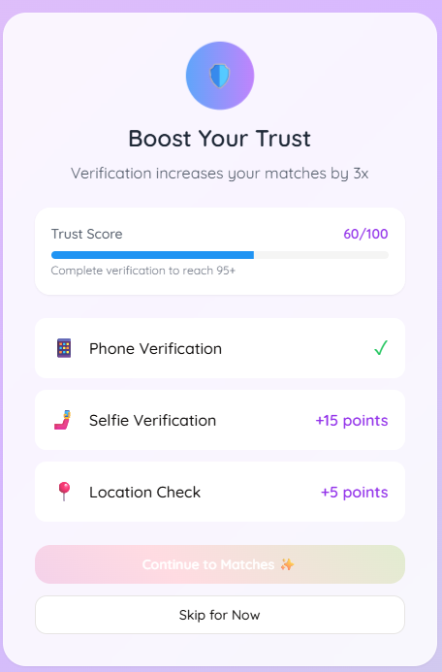
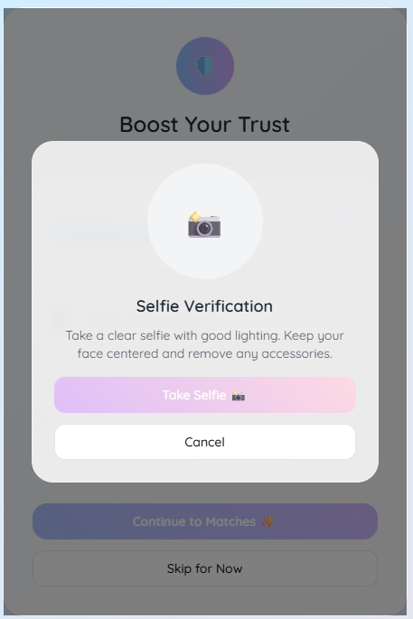
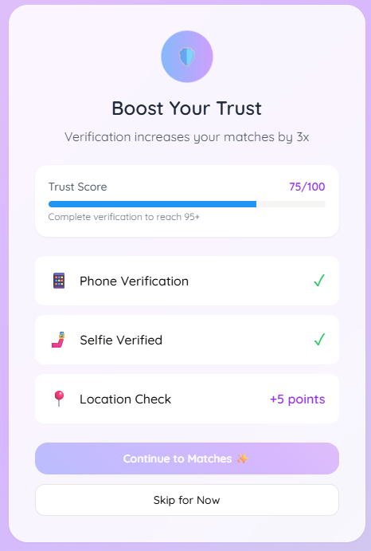
Wireframes 5– 6– 7 Verification
Title: “Profile Verification” Content:
Wireframes for:
Step-by-step Verification Process
Highlight: Trust Score Bar
21

Slide 21
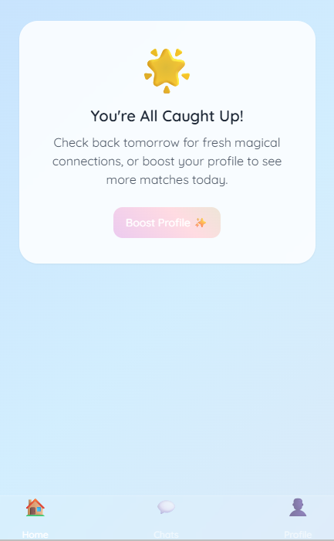
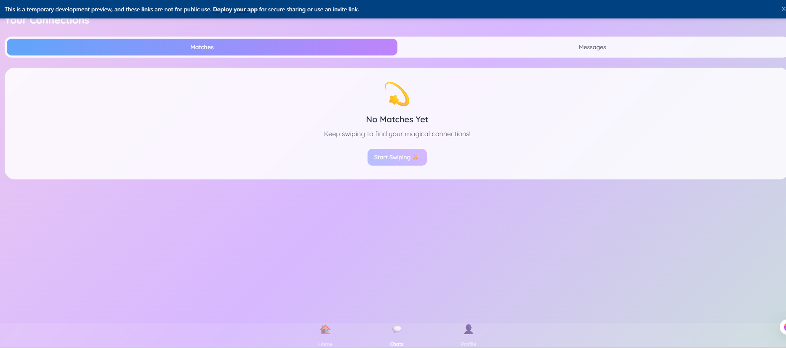
Wireframe 8 – 9 – Match Feed & Chat
Title: “Daily Matches & Conversations” Content:
Wireframe: Match card feed
Wireframe: Chat UI with XP, streaks
Caption: “Core value delivery happens here — meaningful conversation over mindless swipes.”
LuvNimbus
22

Slide 22
User Experience Flow at a Glance 🗺️➡️
The LuvNimbus user journey is designed to be intuitive and engaging, guiding users seamlessly from their first interaction to meaningful conversations. It begins with an inviting splash screen, leading to a straightforward login/signup process. Comprehensive onboarding ensures profiles are rich and verified. Users then receive daily curated matches, can express interest, confirm a match, and finally, start chatting within an interface that integrates XP and a ghosting meter to encourage healthy interaction. Our goal is a delightful and trust-filled experience at every step.
2. Daily Match
1. Onboarding
Receive curated matches daily
Splash → Login/Signup → Photos, Info, Verification
4. Chat & Engage
3. Interaction
Start Chat → XP & Ghosting Meter
Like/Skip → Match Confirmation
23

Slide 23
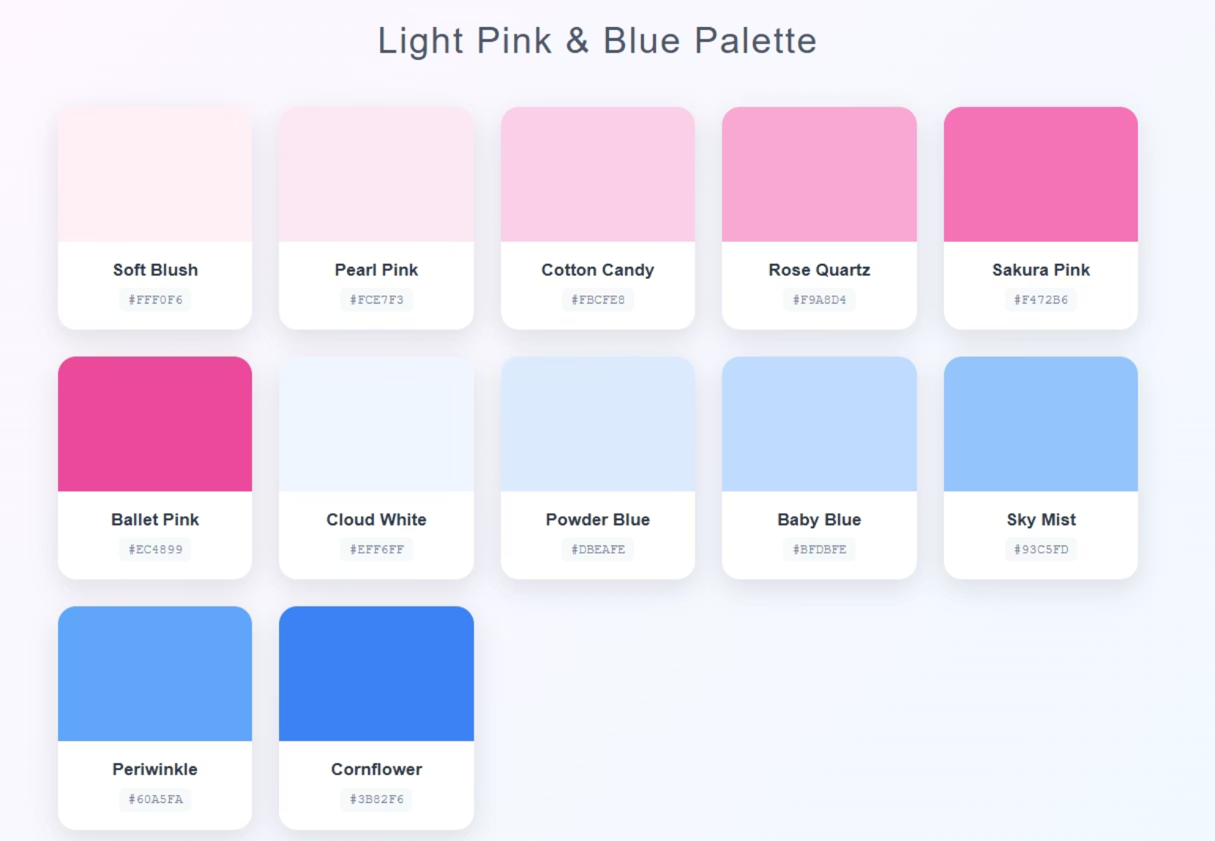
Magical, Inviting, and Whimsical Branding ✨🧚
LuvNimbus's visual identity is crafted to evoke a sense of magic, invitation, and whimsy, setting us apart from the often-sterile or overly bold aesthetics of other dating apps. Our branding is characterized by soft pastel gradients that create a calming and approachable feel, complemented by cloud-rainbow UI elements that reinforce our unique name and promise. Interactive elements feature subtle sparkle and fairy animations, adding a touch of enchantment to every user interaction and making the experience truly memorable.
Style Highlights
Soft pastel gradients
Cloud-rainbow UI elements
Sparkle & fairy animations for interactions
24

Slide 24
AI & Trust – Our Innovative Tech Stack 🤖🔒
The technological backbone of LuvNimbus is built on a robust and innovative stack, designed to ensure both seamless user experience and paramount security. Our frontend, developed with HTML, CSS, and React on Replit, provides a responsive and intuitive interface. The backend, powered by Flask/Express, handles data processing and application logic efficiently. For advanced intelligence and trust features, we integrate cutting-edge AI: GPT-4 for engaging icebreakers, Azure Face Verification for reliable identity checks, and HuggingFace for abuse classification. All data is securely managed with SQLite, hosted on Replit DB, ensuring a reliable and scalable foundation.
1
Database
SQLite (Replit DB)
2
Backend
Flask/Express
3
AI Integrations
GPT-4 Icebreakers, Azure Face Verification, HuggingFace Abuse Classifier
4
Frontend
HTML/CSS/React (Replit)
25

Slide 25





Core Functional Features: Building Meaningful Connections 💑
Daily Curated Matches 🎯
Selfie Verification for Trust Scores ✅
Real-Time Chat & Gamification 💬
Experience personalized matchmaking with 3-5 daily profiles tailored to your preferences, ensuring quality over quantity. Our algorithm learns and adapts, presenting profiles that truly align with your interests and relationship goals, making every match a potential meaningful connection.
Boost your confidence in every interaction with our robust selfie verification system. This feature assigns trust scores to profiles, significantly reducing the presence of fake accounts and fostering a secure environment for all users. Trust is paramount in dating, and we're building it in.
Engage in lively conversations with our real-time chat, enhanced by fun gamification elements. Earn points, unlock achievements, and enjoy interactive features that make connecting with others more enjoyable and less intimidating, encouraging deeper conversations.
AI-Generated Icebreakers 🤖
Community-Based Reporting & Moderation 🤝
Never struggle with opening lines again! Our AI-powered icebreakers provide personalized conversation starters, helping you initiate engaging discussions and effortlessly connect with your matches. Break the ice with witty and relevant prompts.
LuvNimbus prioritizes user safety through a robust community-driven reporting and moderation system. Users can report inappropriate behavior, and our dedicated team ensures swift action, maintaining a respectful and safe space for everyone to interact.
26

Slide 26

Quality & Compliance Goals: A Foundation of Excellence 🏛️
Load Speeds <2 Seconds ⚡
Our commitment to an exceptional user experience begins with lightning-fast load times. We ensure that LuvNimbus launches and navigates seamlessly, with all core features loading in under two seconds. This optimizes user engagement and minimizes frustration.
Security: JWT & Encryption 🔒
User data privacy and security are non-negotiable. LuvNimbus employs industry-leading JSON Web Tokens (JWT) for secure authentication and end-to-end encryption for all communications, safeguarding your personal information and conversations.
Privacy: GDPR & CCPA Compliance 📜
We adhere strictly to global data privacy regulations, including GDPR and CCPA. Our privacy policies are transparent, and user consent is paramount, ensuring your personal data is handled responsibly and ethically.
Accessibility: WCAG 2.1 AA ♿
LuvNimbus is designed to be inclusive and accessible to everyone. We follow WCAG 2.1 AA guidelines, ensuring our platform is usable by individuals with diverse abilities, fostering a truly universal dating experience.
Our dedication to quality ensures that LuvNimbus provides a secure, private, and accessible platform. We believe that a robust technical foundation is key to building lasting trust with our users and delivering a premium experience. This commitment extends beyond functionality to every aspect of the app's performance and compliance.
Multilingual Support 🗣️
To cater to a diverse user base, LuvNimbus offers multilingual support, initially covering English and three key Indian languages. This enhances user comfort and broadens our reach within various linguistic communities across the region.
27

Slide 27
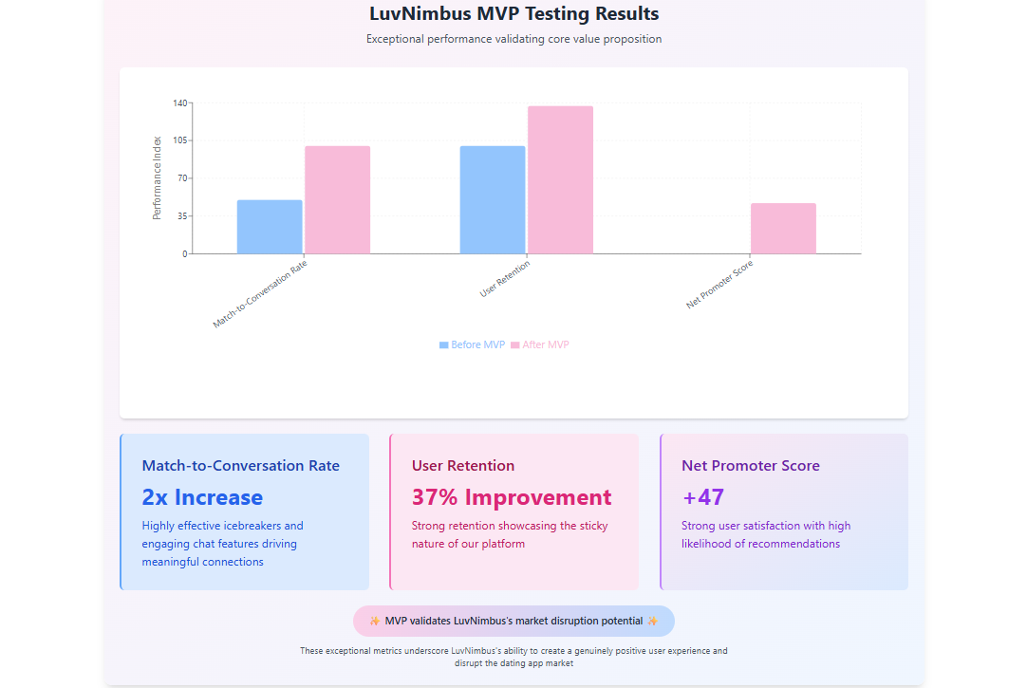
MVP User Testing Insights: Proving Our Impact ✨
28

Slide 28
Product Roadmap: Expanding Horizons 🚀
Our vision for LuvNimbus extends far beyond the current MVP. We have a robust product roadmap designed to continuously enhance the user experience, introduce innovative features, and strategically expand our market reach. This phased approach ensures sustainable growth and maintains our competitive edge in the evolving dating landscape.
Phase 1: Enhanced Communication Tools 🎙️
1
Implement voice introductions to add a personal touch to profiles and introduce AI conversation guidance to help users navigate tricky discussions and foster deeper connections, making interactions more authentic and less awkward.
2
Phase 2: Community & Family Features 👨‍👩‍👧‍👦
Empowers culturally conscious users to share match profiles with trusted family or friends through a secure, limited-view link. This feature supports arranged or semi-arranged dating, promotes transparency, and fosters meaningful involvement while preserving user privacy.
Phase 3: Premium Monetization & Engagement 💎
3
Roll out premium features including XP boosts for faster progress, exclusive premium badges to showcase status, and community events to foster real-world connections, providing tangible value for our premium subscribers.
4
Phase 4: Geographic Scaling 🗺️
Strategically expand LuvNimbus's reach across India, tapping into diverse regional markets. Following successful expansion within India, we plan to venture into Southeast Asia, bringing our emotionally intelligent dating platform to new territories.
29

Slide 29
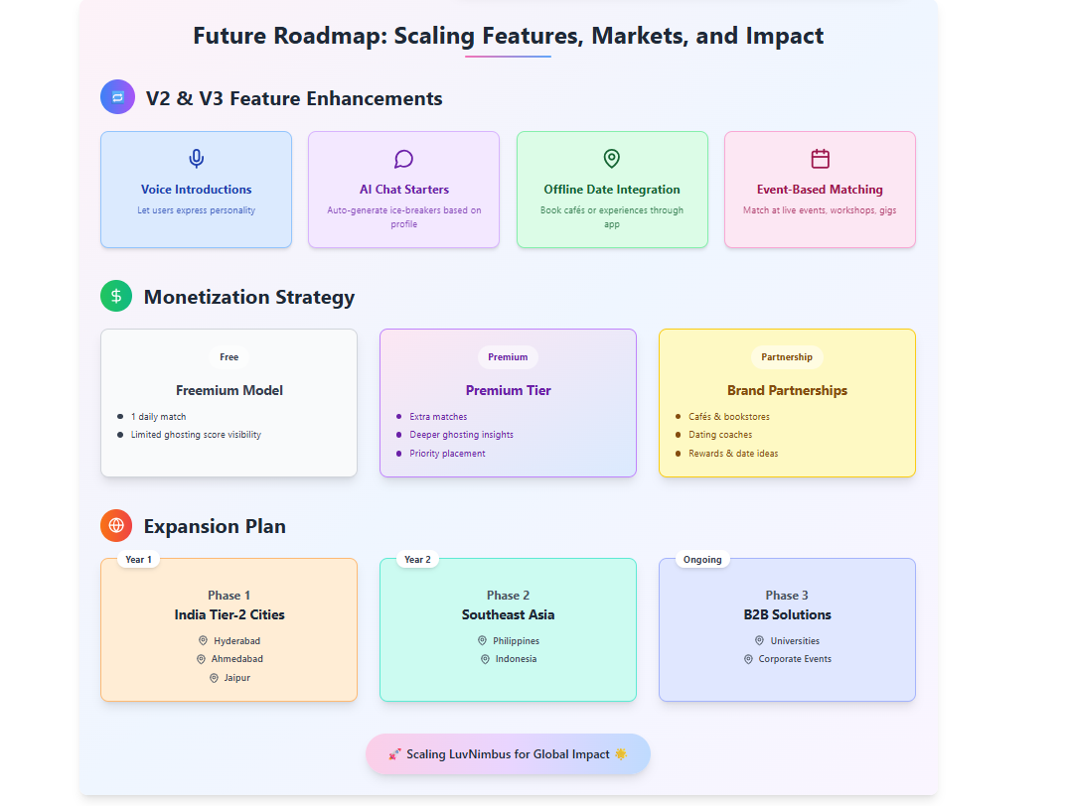

Slide 30

LuvNimbus: Not Just a Product, an Emotional Upgrade 🥰
LuvNimbus stands apart as more than just a dating app; it's an emotional upgrade for our users. We've meticulously designed a platform that fosters genuine connections through emotionally intelligent algorithms, moving beyond superficial swipes to truly understand and match individuals based on deeper compatibility.
Emotionally Intelligent Dating ❤️
Our algorithms prioritize emotional compatibility and nuanced preferences, creating matches that resonate on a deeper level than traditional dating apps.
Built-in Trust Mechanisms 🛡️
With features like selfie verification and community-based moderation, we've engineered trust directly into the platform, ensuring a safer and more authentic dating environment.
Proven Early Success in User Satisfaction 📈
Our MVP results speak for themselves: significantly increased conversation rates, improved retention, and a strong NPS score confirm LuvNimbus's ability to delight and satisfy its users.
30

Slide 31
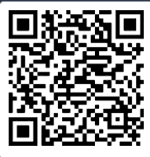


Explore LuvNimbus Now! ✨
Ready to experience the future of dating? 📲
Scan the QR code to instantly download and explore the LuvNimbus prototype. See firsthand how our innovative features create a more secure, engaging, and emotionally intelligent dating experience. This is your chance to be among the first to witness the magic.
Join the LuvNimbus community and embark on a journey towards more meaningful connections. Your next great story starts here! Don't miss out on the opportunity to be part of something truly special.
31

Slide 32

LuvNimbus: Connecting Hearts, Building Trust 💖🔐
Thank you for joining us on this journey to explore LuvNimbus. We are confident that our emotionally intelligent approach, coupled with robust trust mechanisms and proven user satisfaction, positions us uniquely in the market.
We are excited about the future of LuvNimbus and the profound impact it will have on millions of lives. We believe in creating a world where every connection has the potential to be truly meaningful.
Let's collaborate to bring this vision to life and redefine the landscape of digital dating. We are open to discussions and partnerships that align with our mission of fostering genuine connections and emotional well-being. Together, we can make LuvNimbus a global leader in the dating industry. Feel free to reach out with any questions. 💖
32

